Slide 1
RMI and CORBA
Compiled by: Er. Juned Alam

Slide 2
Centralized system
Upto swing app development, we have been studying and practising our java codes as a centralized system.
That means, all of our code and resources resides within a particular machine.

Slide 3
Distributed system
In the chapter network programming, we have seen the distributed system at play, as our java code resides in two different machines; namely: client and server machines.
Can we call our servlets and jsps and servlets as distributed system?

Slide 4
Technologies to achieve Distributed system using java
For homogeneous system, we have RMI (Remote Method Invocation)
For heterogeneous system, we have CORBA (Common Object Request Broker Architecture)

Slide 5
Remote Method Invocation (RMI)
Remote Method Invocation (RMI) model represents a distributed object application. RMI allows an object inside a Java Virtual Machine (JVM) (particularly on a client side) to invoke a method on an object running on a remote JVM (particularly on a server side).

Slide 6
Lets look at how JVM’s memory management works for objects.

Slide 7
JVM’s memory management within the same machine
Stack memory area
Heap memory area
Object_1
Object_2
Object_1 | 007
Object_2 | 008
007
008

Slide 8
JVM’s memory management in different machines (RMI’s model)
Stack memory area
Heap memory area
Object_1
Object_2
rmiregistry
Object_1 | 007
Object_2 | 008
007
008
Stub
Skeleton
Notes:
test

Slide 9
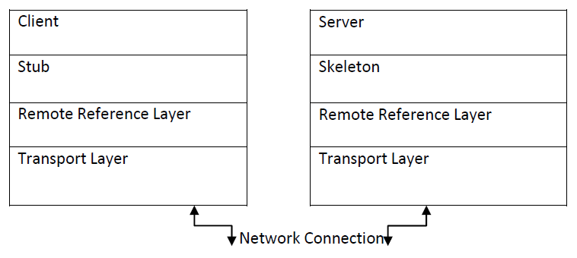
RMI’s architecture

Slide 10
Steps to develop a remote interface using RMI
Create the remote interface
Implementation of Remote Interface
Compile, stub and skeleton (rmic)
Start the registry
Create and start the server
Create and start the client

Slide 11
1. Create the remote interface
import java.rmi.Remote;
public interface AddI extends Remote {
void add(int var1, int var2) throws Exception;
}

Slide 12
2. Implementation of Remote Interface
import java.rmi.server.UnicastRemoteObject;
public class Adder extends UnicastRemoteObject implements AddI {
public Adder() throws Exception { }
public void add(int var1, int var2) throws Exception {
System.out.println("the result is " + (var1 + var2));
}
}
Notes:
Throws remote exception

Slide 13
Server class
import java.rmi.Naming;
public class Server{
public static void main(String[] args) throws Exception {
Adder adder = new Adder();
Naming.bind("add",adder);
System.out.println("Server started");
}
}

Slide 14
Client class
import java.rmi.Naming;
public class Client{
public static void main(String[] args) throws Exception {
System.out.println("Client started");
AddI addI = (AddI) Naming.lookup("add");
addI.add(10,20);
}
}

Slide 15
3. Compile, stub and skeleton (rmic)
>javac *.java

Slide 16
4. Start the RMI registry
>start rmiregistry

Slide 17
5. Create and start the server
>java Server

Slide 18
6. Create and start the client
>java Client

Slide 19
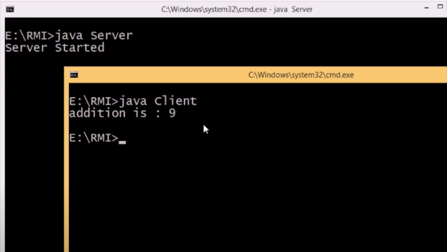
Output

Slide 20
Common Object Request Broker Architecture (CORBA)
Object Management Group (OMG): a non-profit industry consortium formed in 1989 with the goal to develop, adopt, and promote standards for the development of distributed heterogeneous applications.

Slide 21
CORBA contd.
The CORBA specification details the interfaces and characteristics of the Object Request Broker; it practically specifies the middleware functions which allow application objects to communicate with one another no matter where they are located, who has designed them and in which language they are implemented.

Slide 22
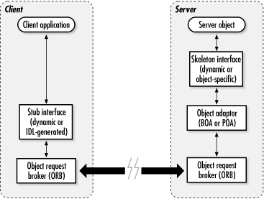
CORBA architecture

Slide 23
CORBA services
Naming Service
Event Service and notification Service
Security service
Trading service
Transaction service and concurrency control service
Persistent state service
Life cycle service
Notes:
Naming and Trading Services:
• The basic way an object reference is generated is at
creation of the object when the reference is returned.
• Object references can be stored together with
associated information (e.g. names and properties).
• The naming service allows clients to find objects
based on names.
• The trading service allows clients to find objects
based on their properties.
☞ Transaction Management Service: provides twophase
commit coordination among recoverable
components using transactions.
☞ Concurrency Control Service: provides a lock
manager that can obtain and free locks for
transactions or threads.
☞ Security Service: protects components from
unauthorized users; it provides authentication,
access control lists, confidentiality, etc.
☞ Time Service: provides interfaces for synchronizing
time; provides operations for defining and managing
time-triggered events.
- - - - - - - - - - - - - - - - - - - - - - - - - -

Slide 24
RMI pros and cons
pros | cons
Portable across many platforms | Tied only to platforms with Java support
Can introduce new code to foreign JVMs | Security threats with remote code execution, and limitations on functionality enforced by security restrictions
Java developers may already have experience with RMI (available since JDK1.02) | Learning curve for developers that have no RMI experience is comparable with CORBA
Existing systems may already use RMI - the cost and time to convert to a new technology may be prohibitive | Can only operate with Java systems - no support for legacy systems written in C++, Ada, Fortran, Cobol, and others (including future languages).

Slide 25
CORBA pros and cons
pros | cons
Services can be written in many different languages, executed on many different platforms, and accessed by any language with an interface definition language (IDL) mapping. | Describing services require the use of an interface definition language (IDL) which must be learned. Implementing or using services require an IDL mapping to your required language - writing one for a language that isn't supported would take a large amount of work.
With IDL, the interface is clearly separated from implementation, and developers can create different implementations based on the same interface. | IDL to language mapping tools create code stubs based on the interface - some tools may not integrate new changes with existing code.
CORBA supports primitive data types, and a wide range of data structures, as parameters | CORBA does not support the transfer of objects, or code.

Slide 26
CORBA pros and cons contd
pros | cons
CORBA is ideally suited to use with legacy systems, and to ensure that applications written now will be accessible in the future. | The future is uncertain - if CORBA fails to achieve sufficient adoption by industry, then CORBA implementations become the legacy systems.
CORBA is an easy way to link objects and systems together | Some training is still required, and CORBA specifications are still in a state of flux.
CORBA systems may offer greater performance | Not all classes of applications need real-time performance, and speed may be traded off against ease of use for pure Java systems.

Slide 27
Thank you

